Slide 1




PAGE 01
PharmaBridge
Bridging the gap between surplus and need in medical donations
Supervisor :
Dr. Ahmed Elsyed yakoub
Eng. Khaled Mohamed Mahmoud

Slide 2
Team Members
PAGE 02
⚬ Shahd Alaa Mostafa
⚬ Salma Emad Mohamed
⚬ Yomna Ali Ibrahim
⚬ Mohamed Abd-Elrheem
⚬ Kareem Ahmed Mohamed
⚬ Ahmed Essam Eldeen
⚬ Ahmed Abd-ElHalim Ali
(21-01595)
(21-02292)
(21-01701)
(21-01149)
(21-00839)
(21-00328)
(20-01089)

Slide 3
Agenda
PAGE 03
Introduction
Comparison With Other Solutions
Motivation
Solution
Limitations
System Analysis
Future Work
Implementation
Project Backlog
Testing & Evaluation
UI Design

Slide 4
Introduction
PAGE 04
Purpose: Reduce medical waste & improve healthcare accessibility.
Key Benefits:
Minimizes environmental impact of discarded medications.
Lowers medication costs for recipients.
Increase access to medications and reduction of wastages.
Process:
Donors list available medications.
Recipients browse & request needed medications.
System facilitates secure & efficient exchanges.

Slide 5
Motivation
PAGE 05
Problem 1
Problem 2
Medical Waste & Environmental Impact
Large quantities of unused medications are discarded, leading to pollution and unnecessary waste.
Limited Access to Essential Medications
High medication costs prevent many individuals from affording necessary treatments.

Slide 6

Motivation
PAGE 06
Problem 3
Problem 4
Lack of Efficient Redistribution
No streamlined system exists to connect donors with recipients effectively.
Social Responsibility Gap
Low awareness and participation in medication donation initiatives.

Slide 7
Solution
PAGE 07
1.Donor Registration - Donors list surplus medications with details like expiration date and status.
2.Recipient Requests – Users browse available medications and submit requests.
3.Medication Listing – Organized and user-friendly medication listing system.

Slide 8
Solution
PAGE 08
4.Request Process – Recipients search, filter, and request medications with fair distribution limits.
5.Automated Interaction via Chatbot – 24/7 chatbot assistance for donation and request guidance
6.Medication Compatibility Check – Ensures safe medication combinations.

Slide 9
Solution
PAGE 09
7.Priority System for Medication Requests – Matches requests based on expiration date, and cost.
8.User Tracking and Notification System – Notification system that keeps users updated on the status of their medication requests or donations.

Slide 10
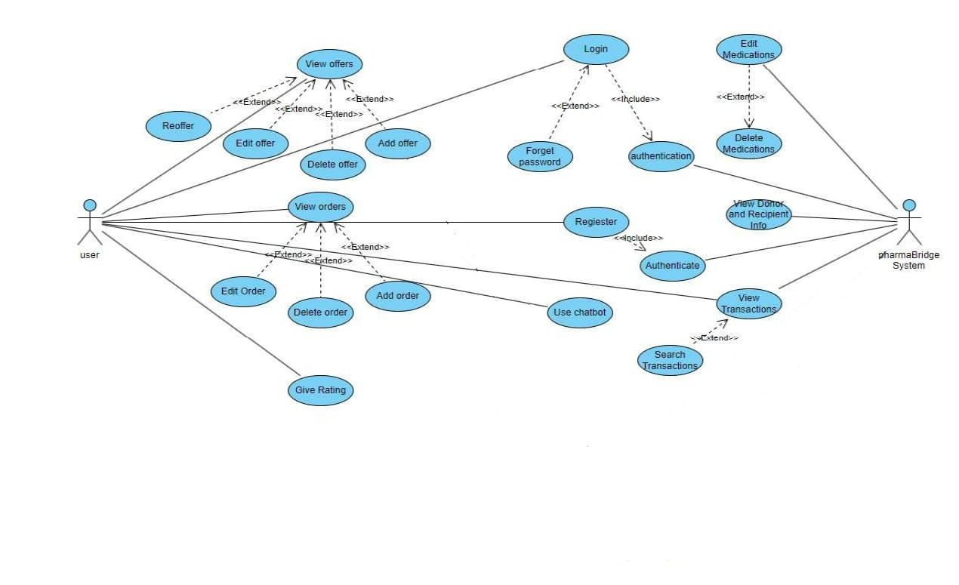
System Analysis
PAGE 10
Donor Functions:
Donate medication: Submit donation requests with medication details.
View Donations: View a list of submitted donations.
Update Donations: Modify previously submitted donations.
Delete Donations: Remove unwanted or incomplete donations.
Give Rating: Provide feedback or a rating after donation.

Slide 11
System Analysis
PAGE 11
Recipient Functions:
Request Medication: Submit a request for needed medication.
View Requests: View a list of submitted requests.
Update Request: Modify existing requests.
Delete Requests: Remove unnecessary requests.
View Notifications: Get notifications on request status and medication availability.

Slide 12
System Analysis
PAGE 12
System Functions:
Authenticate: Verify identity for secure access.
Verify Password: Ensure password validity for secure login.
Match Donor with Recipient: Link donors and recipients based on needs and availability.
Manage Users: Administer user data, including updates and removals.

Slide 13
System Analysis
PAGE 13
Shared Functions:
Login/Register: Both donors and recipients can create or log into accounts.
Forgot Password: Recover forgotten passwords.
Receive Assistance via Chatbot: Get guidance through a chatbot.

Slide 14
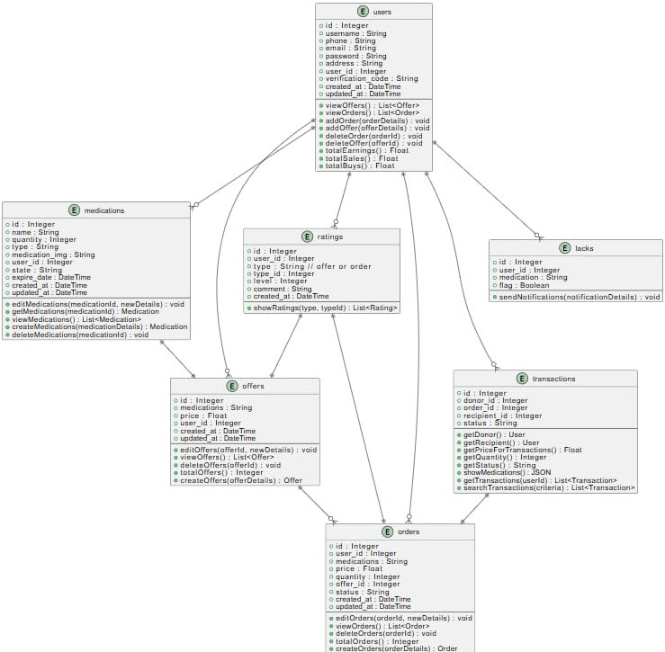
System Analysis
PAGE 14
Class Diagram

Slide 15
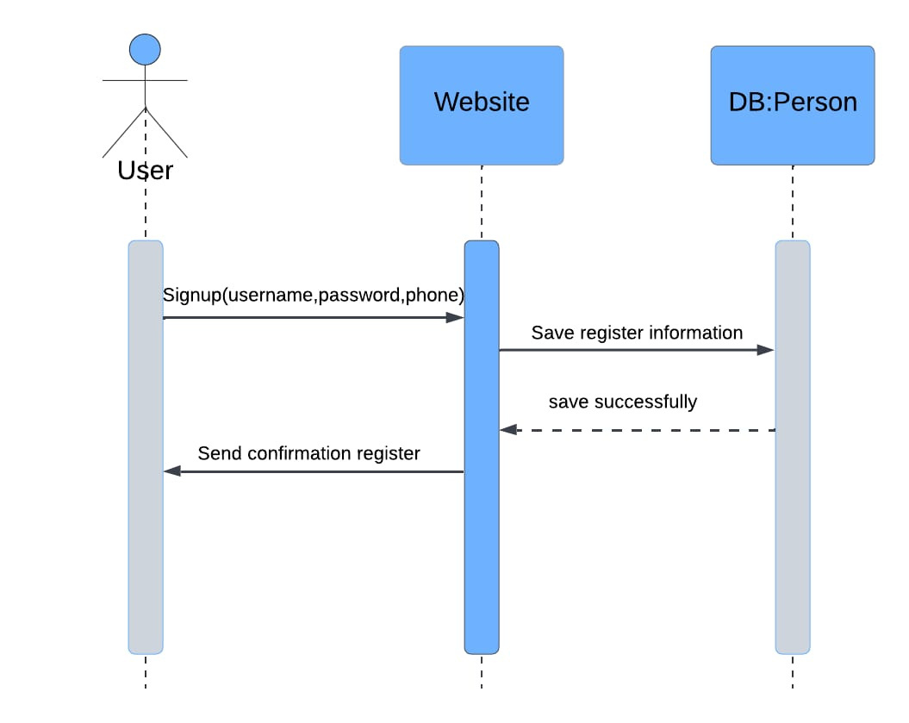
System Analysis
PAGE 15
Sign Up Process:
Enter User Details → Submit Information.
Check for Existing Account:
If exists → Error message displayed.
If new → Verification code sent via email.
User Enters Code → System checks validity.
If invalid → Error message.
If valid → Registration complete, user
redirected to Login.

Slide 16
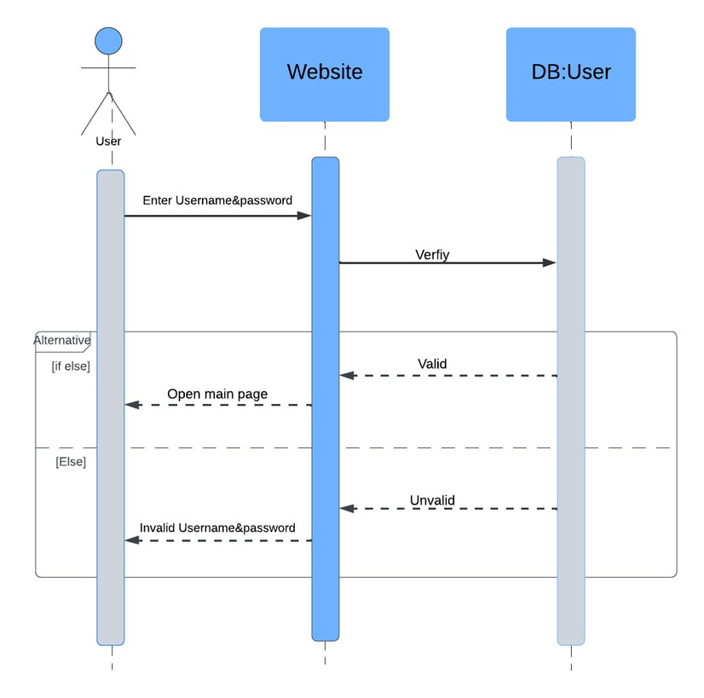
System Analysis
PAGE 16
Login Process:
User enters Username & Password.
Credentials Check:
If correct → Redirect to main page.
If incorrect → Error message displayed.

Slide 17
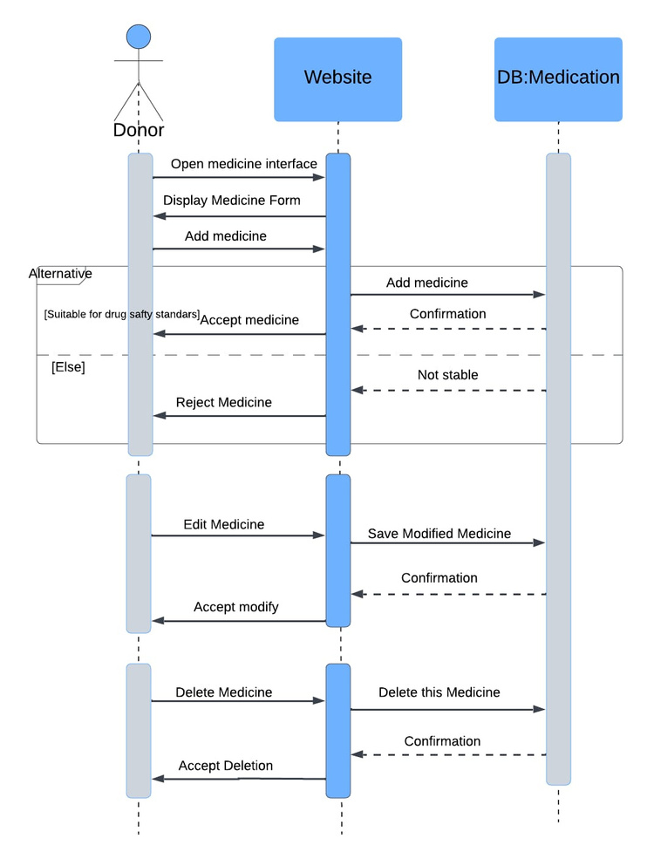
System Analysis
PAGE 17
Add Medication:
User clicks "Add Medication".
Enters medication details.
Delete Medication:
User selects a medication and clicks "Delete".
Confirmation Dialog appears:
Cancel → Medication remains.
Confirm → Medication is deleted, success message shown, and list updated.

Slide 18
System Analysis
PAGE 18
Update Medication:
User selects medication and clicks "Update".
System retrieves and displays edit form.
User modifies details and clicks "Update".
Validation Check:
If invalid → Error message prompts correction.
If valid → Changes are saved, and user returns to the medication list.
View Medication:
User selects medication and clicks "View".
System retrieves and displays medication details.
User can close the window and return to the medication list.

Slide 19
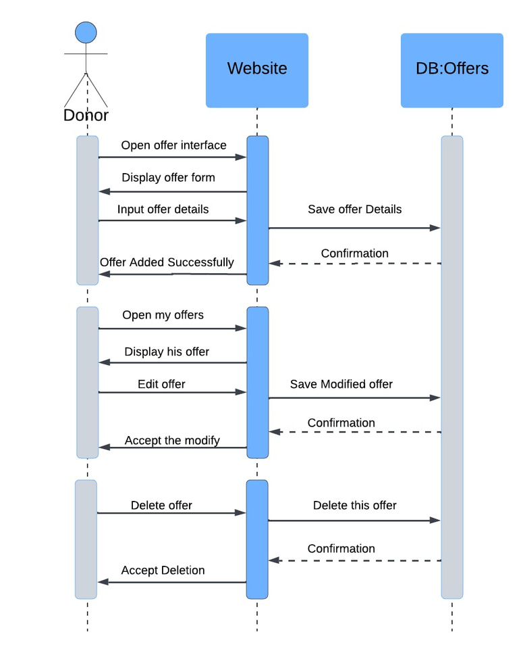
System Analysis
PAGE 19
Offer Process:
Open the Offer Page.
Retrieve the user’s medication list from the database.
Add a new offer by filling out the form.
Submit the offer.
Available Options:
View Offer List → Select offer → View full details.
View Offer List → Select offer → Delet full details.

Slide 20
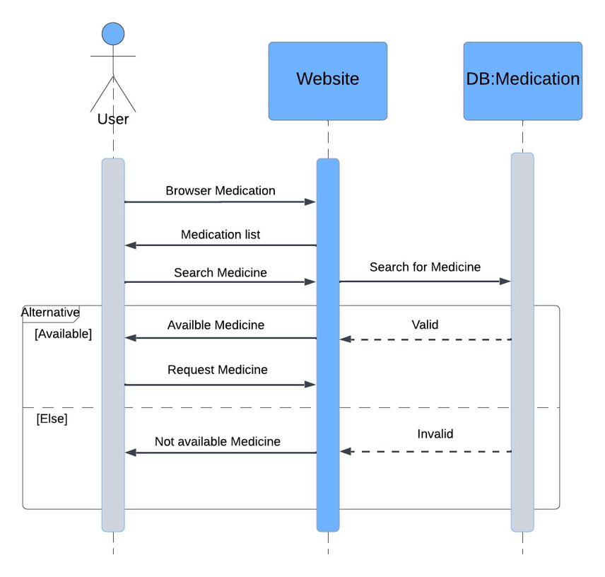
System Analysis
PAGE 20
Order Process:
Order Process:
Open the main Page.
Retrieve all user offers from the database.
Search for the required medicine.
Request the order.
Available Options:
View Order List → Select order → View full details.
View Order List → Select offer → Edit full details.
View Order List → Select offer → Delet full details.
View Order List → Select offer → Change Status.

Slide 21
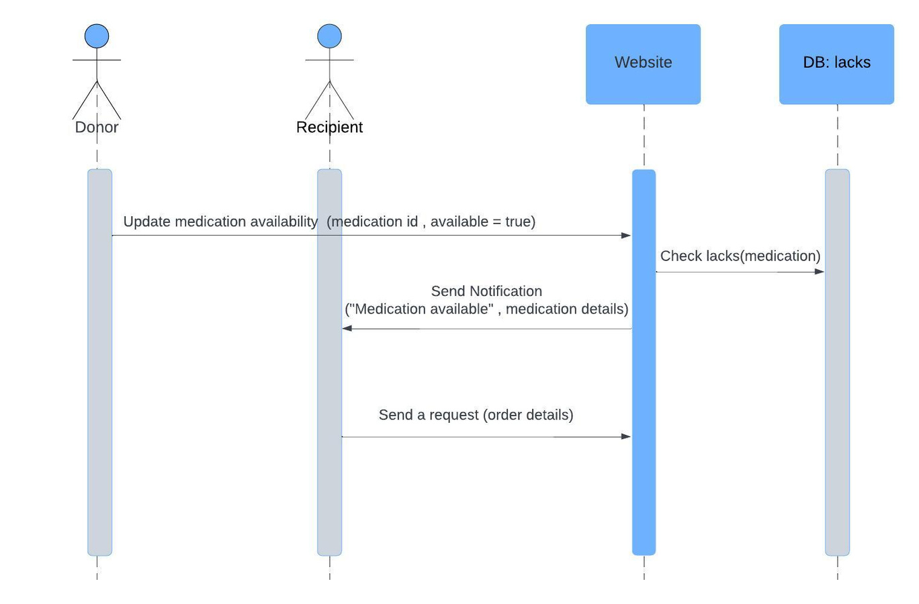
System Analysis
PAGE 21
Check Availability: System verifies
if the requested
medication is available.
Decision Based on Availability:
If Available → User fills out and
submits a
request form for review.
If Unavailable → User can opt to
receive
a notification when the medication
becomes available.

Slide 22
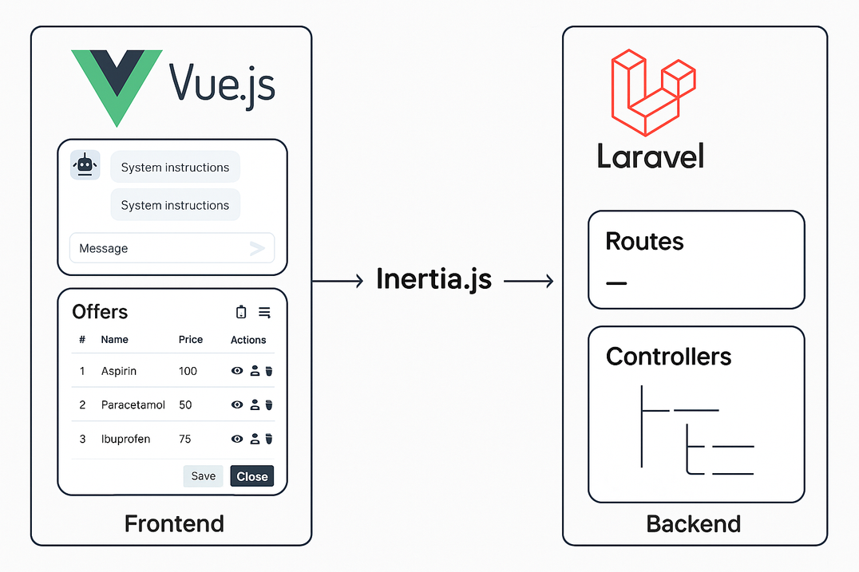
System Analysis
PAGE 22
The architecture follows a MVC structure:
User ↔ Vue.js Interface ↔ Inertia.js ↔ Laravel Controllers
↔ MySQL Database.
Chat interactions pass through the ChatbotController,
which communicates with the local language model
(LLM) to generate appropriate responses.

Slide 23
Implementation Overview
PAGE 23
The system was developed as a Single Page Application (SPA) using Laravel (Backend) and
Vue.js (Frontend), ensuring a seamless and dynamic user experience without full-page reloads.
Laravel routes were designed to handle all logic through dedicated controllers that ensure input validation, data processing, and secure access to system resources.
The frontend is composed of modular Vue components, making the interface highly
maintainable and reusable. These components manage user input, modals and reactive
content updates.
Axios was used for secure and efficient communication between the frontend and backend via asynchronous HTTP requests, allowing real-time interaction and form submissions.

Slide 24
Implementation Overview
PAGE 24
Data such as offers, medications, and orders are presented through interactive modals with
client-side validation, conditional rendering, and visual feedback for better UX.
A local Large Language Model (LLM) was integrated into the system through Laravel’s backend,
enabling dynamic chatbot responses while preserving data privacy and avoiding external
API dependency.
Smart Notification System that alerts users when a medication they previously searched for becomes available in a new offer.
After placing orders, users can rate their experience through a star-based rating system.

Slide 25
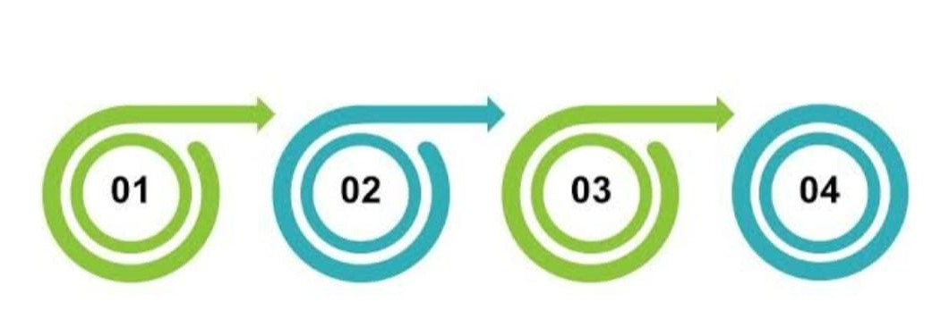
Testing & Evaluation
PAGE 25
Testing Types: Unit testing, integration testing, user testing
Tools Used: Laravel’s testing suite and PHPUnit
Sample Tests: Profile update, email verification, offering process
Results: All essential user flows tested with expected outcomes

Slide 26
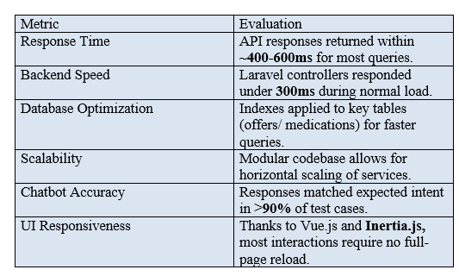
Testing & Evaluation
PAGE 26

Slide 27
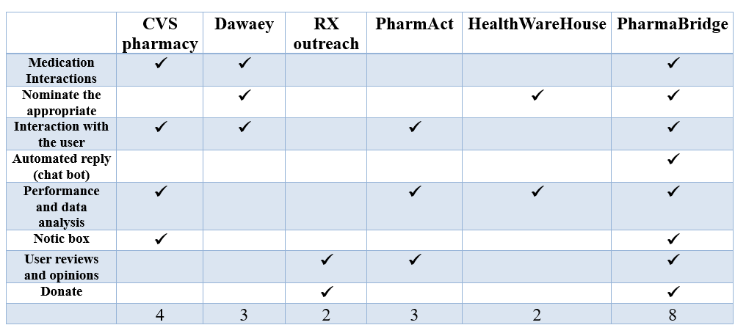
Comparison with Existing Solutions
PAGE 27

Slide 28
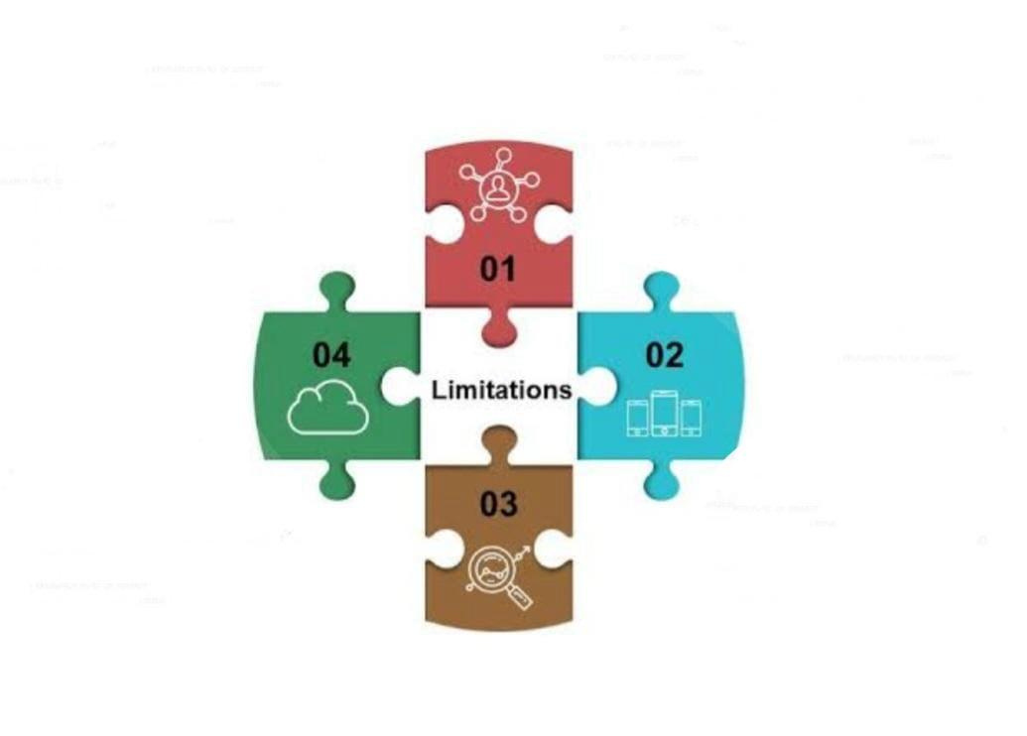
Limitations
PAGE 28
No payment gateway integration
LLM is locally hosted
limits large scale scalability
No mobile app version currently available
Advanced filtering in offer search not yet implemented

Slide 29
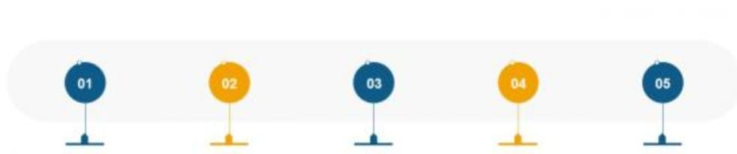
Future Work
PAGE 29
Improve filtering/search mechanisms
Upgrade chatbot with more context awareness and
Cloud-hosting for better scalability.
Integrate secure online payment system.
Add two-factor authentication for enhanced security
provide notifications for order updates, offer status.

Slide 30
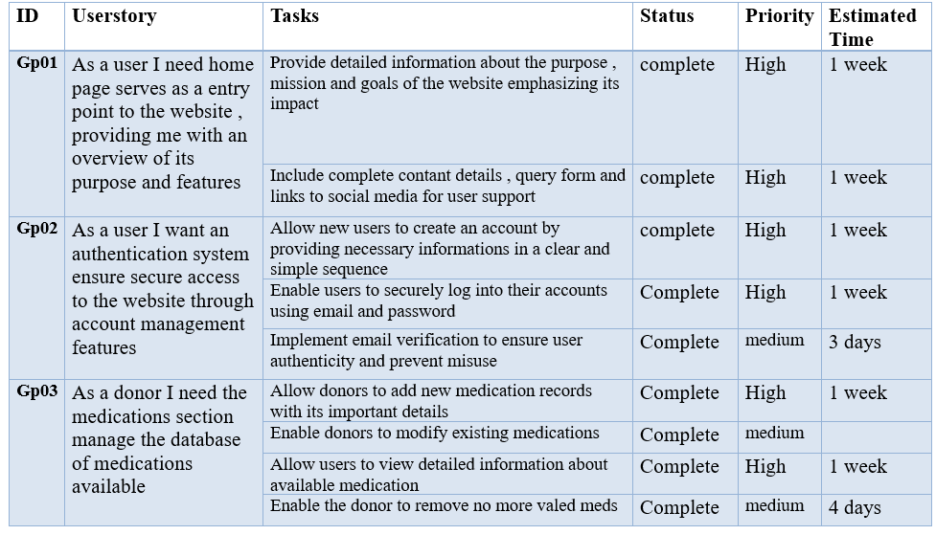
Project Backlog Table
PAGE 30

Slide 31
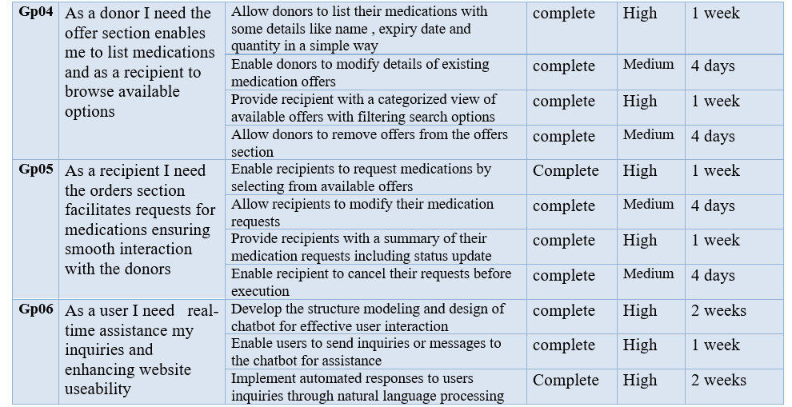
Project Backlog Table
PAGE 31

Slide 32
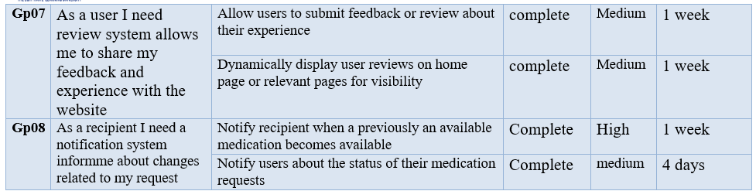
Project Backlog Table
PAGE 32

Slide 33




UI Design
PAGE 33

Slide 34
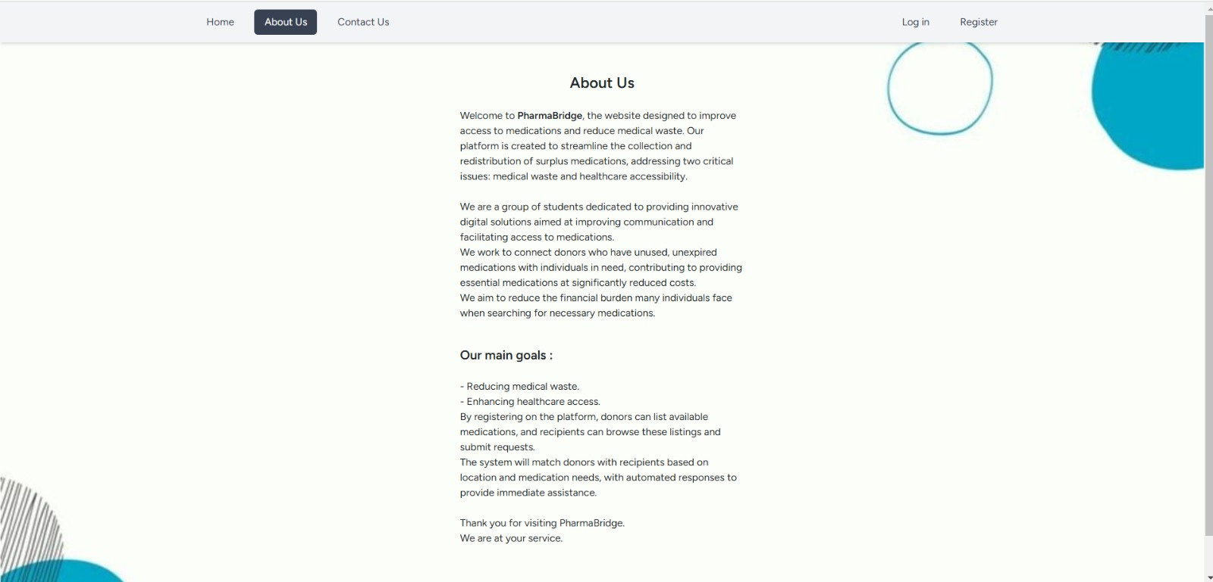
UI Design
PAGE 34

Slide 35
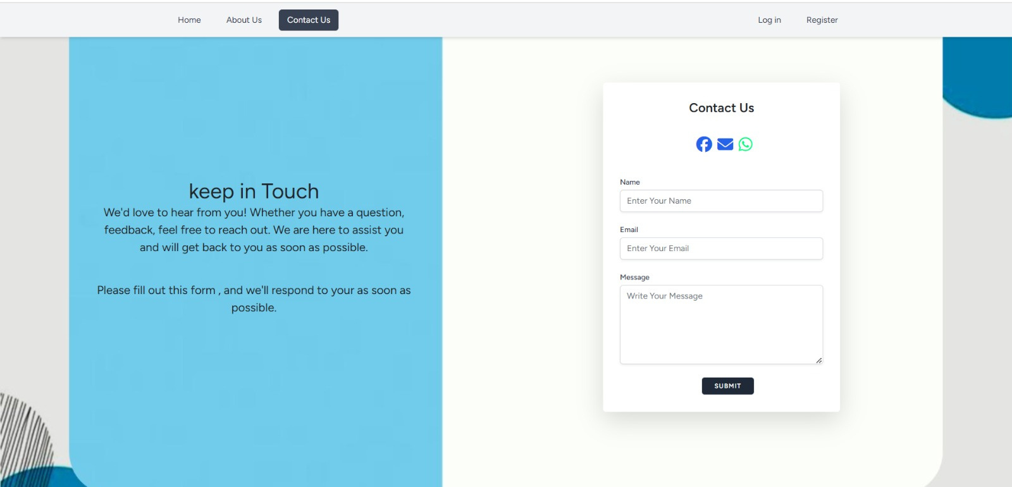
UI Design
PAGE 35

Slide 36
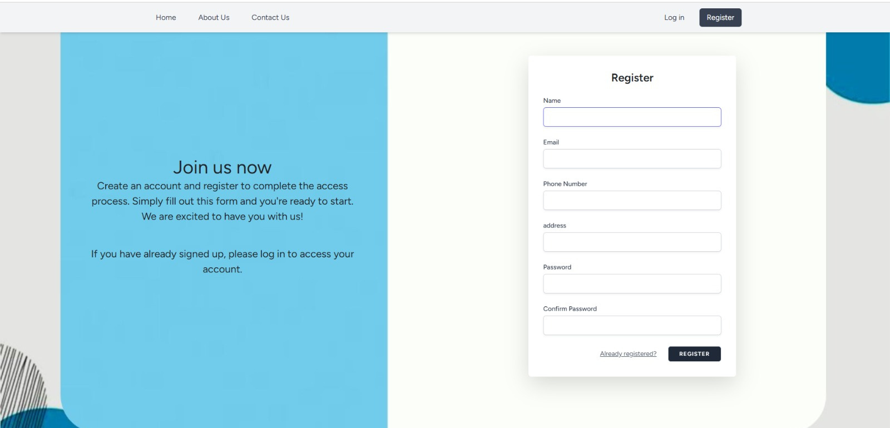
UI Design
PAGE 36

Slide 37
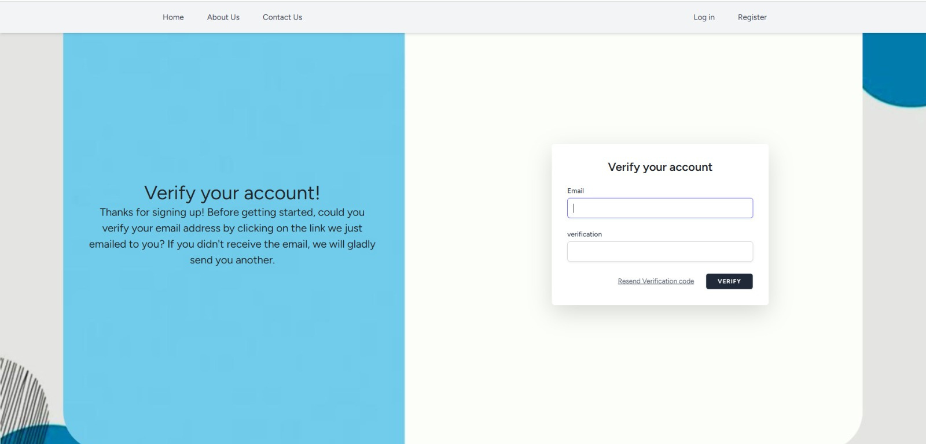
UI Design
PAGE 37

Slide 38
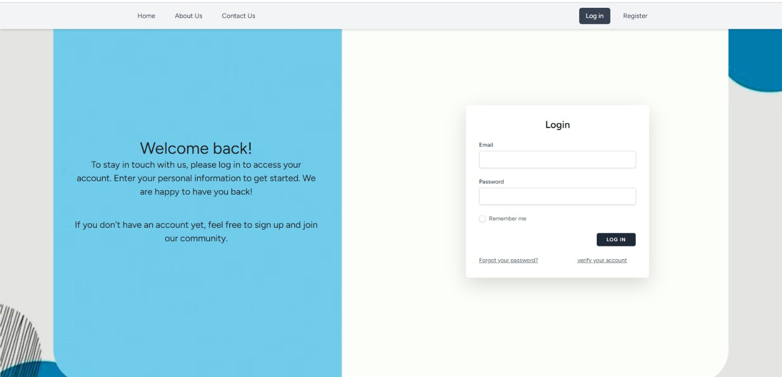
UI Design
PAGE 38

Slide 39
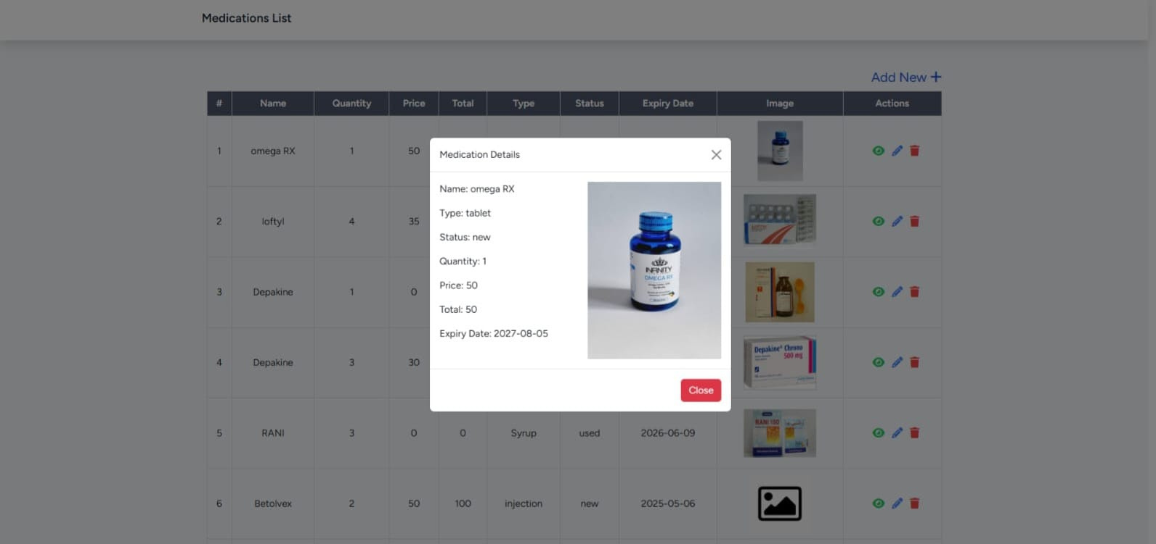
UI Design
PAGE 39

Slide 40
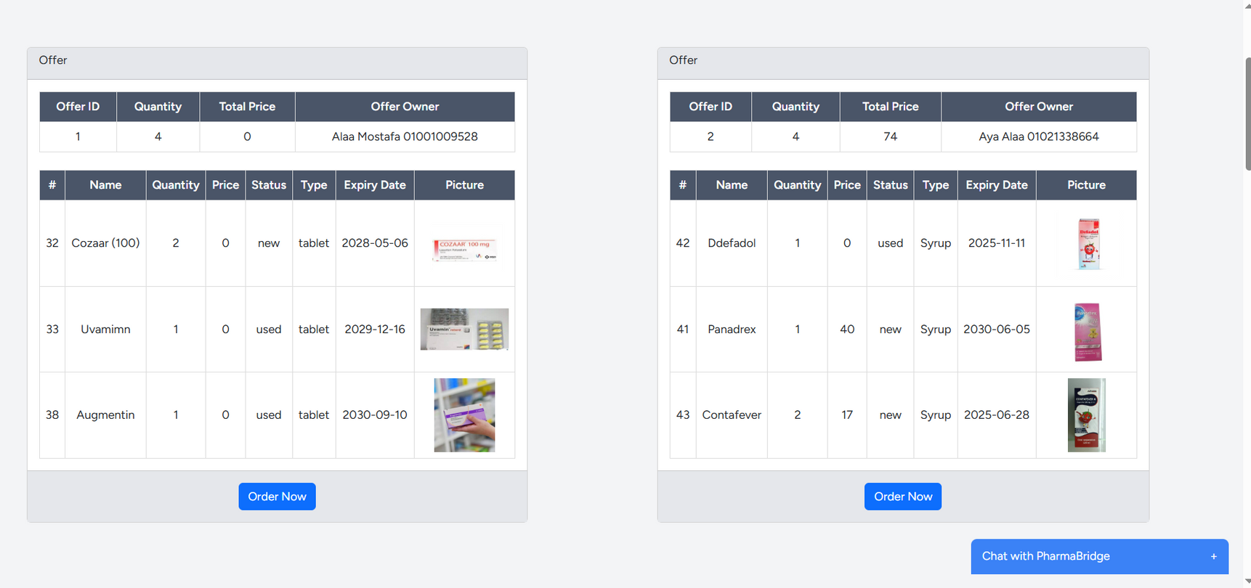
UI Design
PAGE 40

Slide 41
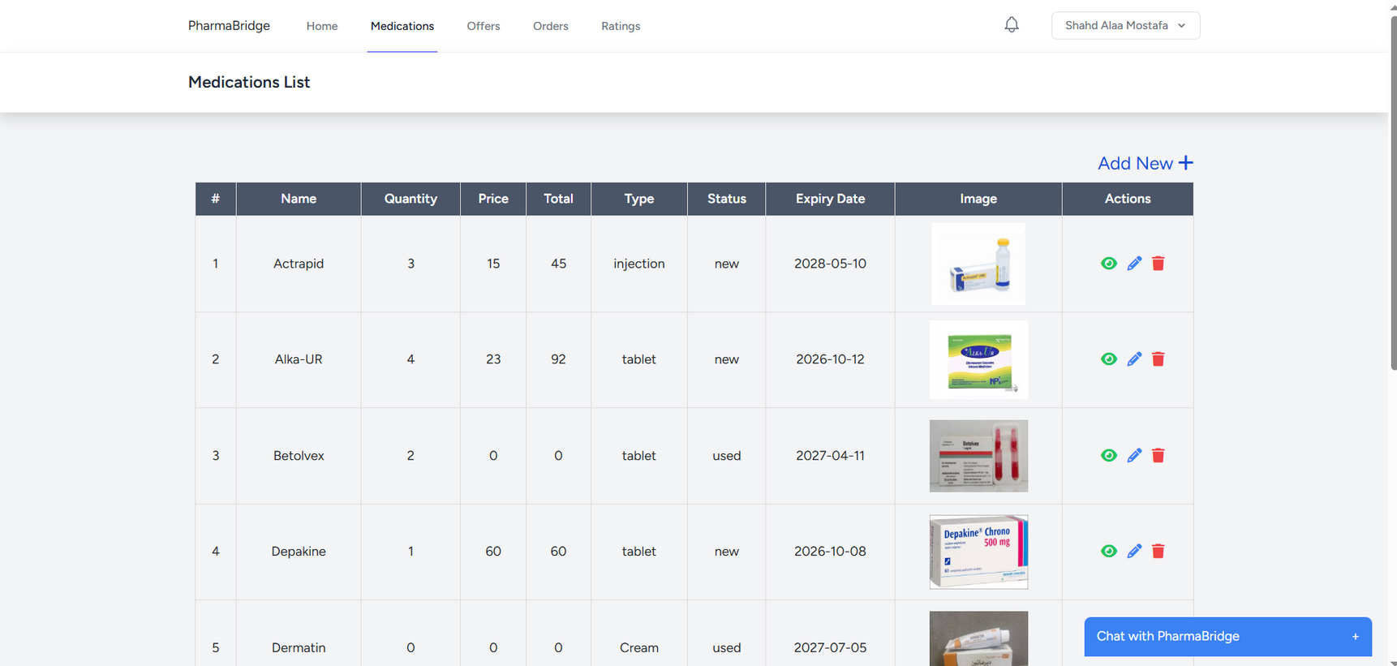
UI Design
PAGE 41

Slide 42
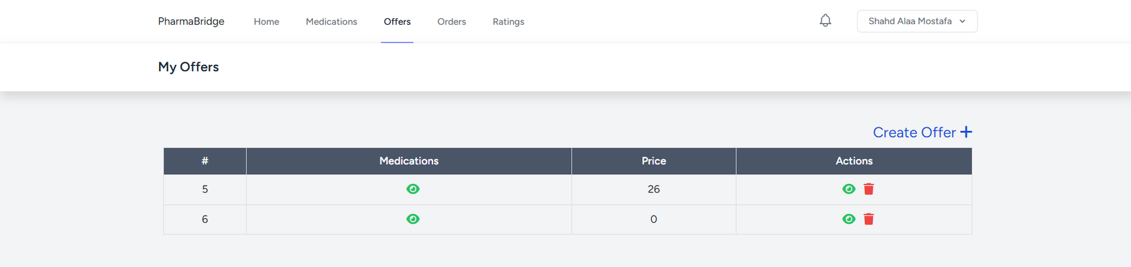
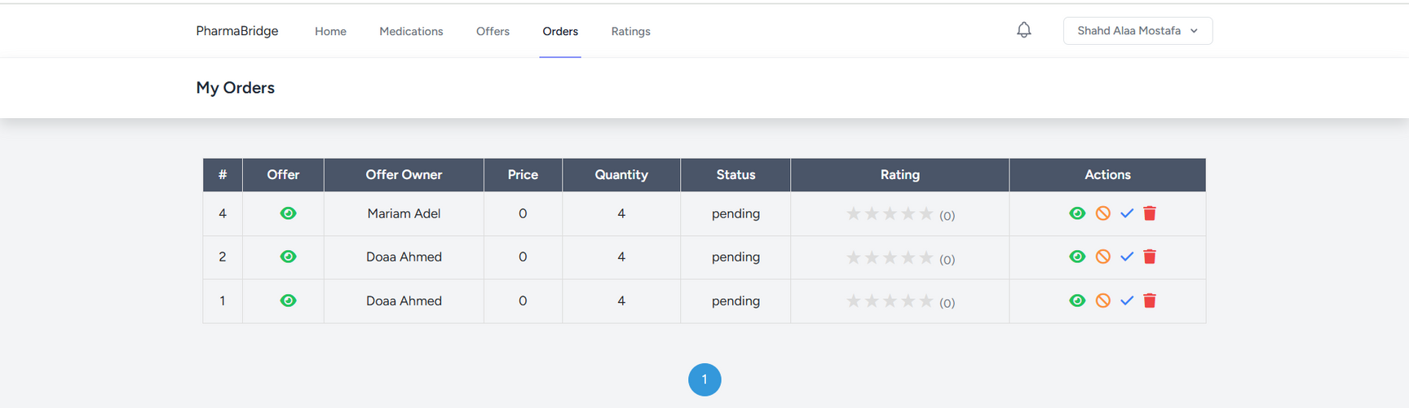
UI Design
PAGE 42

Slide 43
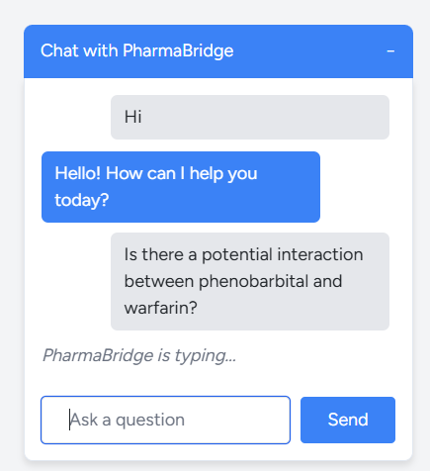
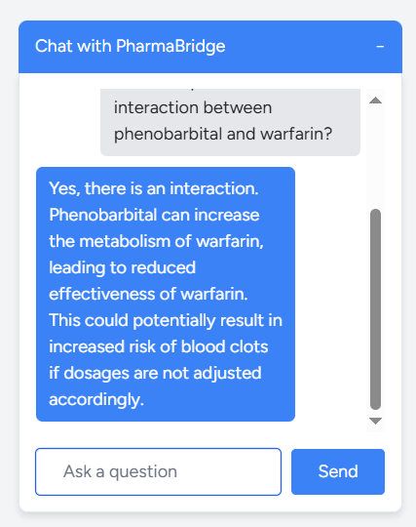
UI Design
PAGE 43

Slide 44
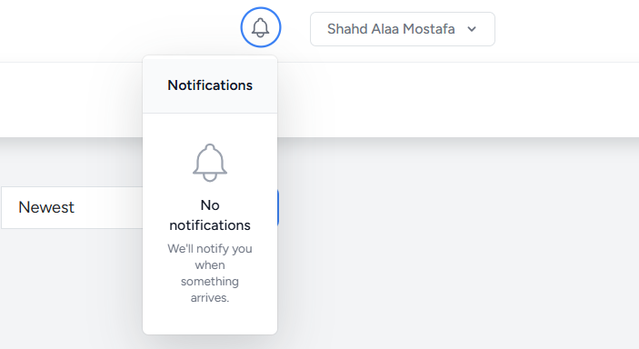
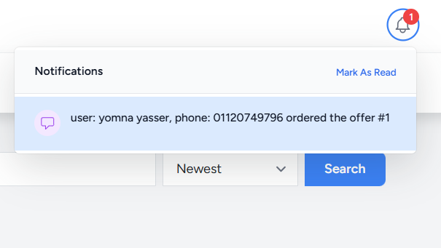
UI Design
PAGE 44

Slide 45
THANK YOU

